Slide 1
Module 6
Implementing DNS
Notes:
Presentation: 115 minutes
Labs: 120 minutes
After completing this module, students will be able to:
Install and manage a Domain Name System (DNS) server.
Configure DNS zones.
Configure name resolution between zones.
Integrate DNS with Active Directory Domain Services (AD DS).
Configure advanced DNS settings.
Required materials
To teach this module, you need the Microsoft PowerPoint file 20741B_04.pptx.
Preparation tasks
To prepare for this module:
Read all the materials for this module.
Practice performing the demonstrations and labs.
Work through the Module Review and Takeaways section, and determine how you will use the information to reinforce student learning and promote knowledge transfer to on-the-job performance.
As you prepare for this class, it is imperative that you complete the labs yourself. This gives you an understanding of how the labs work and the concepts that each covers, so that you can provide meaningful hints to students who might have issues. Furthermore, it will help guide your lecture to ensure that you discuss the concepts that the labs cover.
20741B
4: Implementing DNS

Slide 2
Module Overview
Implementing DNS servers Configuring zones in DNS Configuring name resolution between DNS zones Configuring DNS integration with AD DS
Notes:
Provide a brief overview of the module content.
20741B
4: Implementing DNS

Slide 3
Lesson 1: Implementing DNS servers
How does DNS name resolution work? DNS components What are DNS zones and records? Demonstration: Installing and configuring the DNS role Configuring DNS clients Tools and techniques for troubleshooting name resolution Managing DNS services Demonstration: Troubleshooting name resolution Testing DNS servers Demonstration: Testing the DNS server
Notes:
This is the introductory lesson to DNS Server role. Some students might be familiar with these concepts.
Categorize Activity
Question
Categorize each item into the appropriate category. Indicate your answer by writing the category number to the right of each item.
Answer
Category 1: DNS server
Contains a database of host names and IP addresses
Responds to client requests
If it does not have the needed mapping information, forwards requests to other DNS servers
Category 2: DNS zones
Has both forward and reverse lookup categories
Contains resource records
Scope for replication
Category 3: DNS resolver
Is run by the DNS client service
Generates client requests
Facilitates the caching of resolved mappings in a local client cache for future use
20741B
4: Implementing DNS

Slide 4





How does DNS name resolution work?
A hostname is a computer name that is added to a domain name and top level domain to make a fully qualified domain name (FQDN)
Hostname
Domain
Top level
AcctDirPC
adatum
com
Fully qualified domain name = AcctDirPC.adatum.com
NetBIOS names are rarely used and are being deprecated in Windows operating systems
Notes:
Discuss the different types of names that computers can use. Emphasize that NetBIOS names are rarely used today, and that Windows 7 and newer versions support them only for legacy applications.
Explain the information flow by using the steps in the student notes. Mention to students that understanding this process is important when troubleshooting name resolution issues for clients and servers—such as when a client cannot access a web-based application or file server.
Describe the tasks for which DNS is used. Emphasize the need for DNS to locate domain controllers and global catalog servers. Incorrectly configuring DNS is one of the most common causes of slow computer logons and logon failures. Also, Active Directory replication might fail if DNS is incorrectly configured.
Explain to students that a DNS zone is a specific part of the DNS namespace that can contain DNS records. Give microsoft.com as an example of a zone. Mention that, in most cases, the DNS records that Active Directory requires are added to the necessary zone automatically by domain controllers and global catalog servers. In addition, workstations and servers automatically create their own A records and pointer records, if the zone allows dynamic updates.
20741B
4: Implementing DNS

Slide 5
DNS components
DNS namespace is a hierarchical naming structure that provides multiple identifiers for each network node that can be identified relative to the root domain
computer01.unitedstates.microsoft.com
DNS infrastructure components include:
DNS server
DNS zone
DNS resolvers
Resource records
Notes:
This topic is not intended to give a complete list of all the components and options that go into building a DNS infrastructure. The idea is to give a high-level overview of the main components that go into a DNS infrastructure.
20741B
4: Implementing DNS

Slide 6
What are DNS zones and records?
A DNS zone is a specific portion of DNS namespace that contains DNS records
Zone types:
Forward lookup zone
Reverse lookup zone
Resource records in forward lookup zones include: A, MX, SRV, NS, SOA, and CNAME
Resource records in reverse lookup zones include: PTR
Notes:
Explain to students that a DNS zone is a specific portion of the DNS namespace that can contain DNS records. Use microsoft.com as an example of a zone. If the students are interested, you can discuss that subdomains can be either a separate zone or part of the same zone.
Explain to students what each type of resource record does:
Host (A). Resolves names to IP addresses (you can use websites as an example).
Server (SRV). Locates a domain controller.
Mail exchanger (MX). Locates a mail server.
Pointer (PTR). Resolves an IP address to a host name, when troubleshooting.
Mention that, in most cases, the DNS records required for AD DS are added automatically to the necessary zone by domain controllers and global catalog servers. In addition, workstations and servers create their own A records and PTR records automatically through dynamic updating.
20741B
4: Implementing DNS

Slide 7
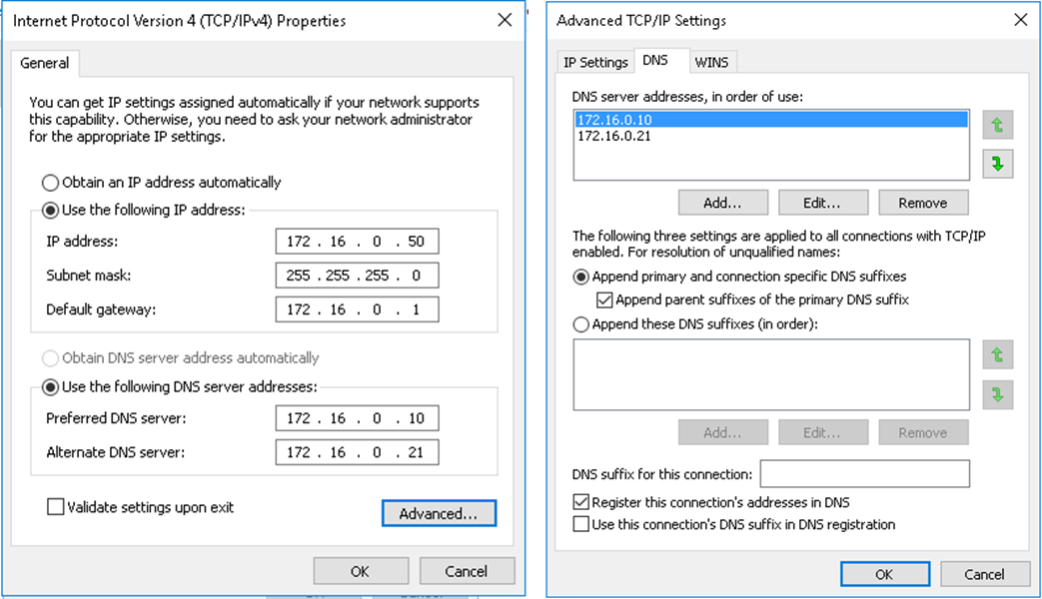
Configuring DNS clients
Set-DnsClientServerAddress -InterfaceIndex 12 -ServerAddresses ("172.16.0.10","172.16.0.21")
Notes:
Explain where and how client settings are configured. Explain that the order in which the DNS servers are queried depends on the configuration of DNS server settings for each network adapter. Guide the students through the DNS server referral order, ensuring that they understand why the order is established in the way it is. Also, point out the Advanced TCP/IP Properties sheet check box that states Register this connection’s addresses in DNS.
20741B
4: Implementing DNS

Slide 8
Managing DNS services
You can manage DNS services by:
Delegating DNS administration through membership in the DNS Admins group
Viewing DNS logs in Event Viewer
Enabling DNS debug logging in the DNS server properties
Enabling aging and scavenging to remove stale records
Backup methods for the DNS database depend on how the database is deployed:
Back up Active Directory–integrated zones through System State backups by using dnscmd or by using Windows PowerShell
Copy or back up primary zone files that are not using AD DS integration
Notes:
Describe management techniques for DNS server. Discuss why it is important to back up DNS zones and the different methods that you can use.
20741B
4: Implementing DNS

Slide 9
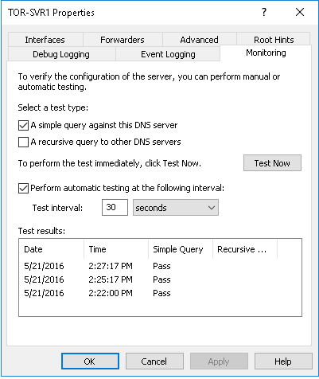
Testing DNS servers
Monitoring tab on DNS Console:
Simple query
Recursive query
Windows PowerShell
Get-DnsServerDiagnostics
Test-DnsServer
Nslookup –d2 FQDN Audit and Analytic event logging:
Use Event Viewer or tracelog.exe
Notes:
Ensure that the students know that Get-DNSClientCache is the Windows PowerShell equivalent of ipconfig /displaydns, and that Clear-DNSClientCache is the equivalent of Ipconfig /flushdns. Explain the new audit and analytic event logs. Mention that you will demonstrate how to use them in the next topic.
20741B
4: Implementing DNS

Slide 10
Lesson 2: Configuring zones in DNS
DNS resource record types Creating records in DNS Configuring DNS zones What are primary and secondary zones? Configuring zone replication
Notes:
Provide a brief overview of the lesson content.
Question
A DNS server is authoritative for a zone if:
( ) Option 1: It is set to Authoritative in the DNS Server Properties.
( ) Option 2: It hosts the resource records in the zone file that is named for the zone.
( ) Option 3: It has multiple CNAME resource records.
( ) Option 4: It is set to Authoritative in the Zone Properties.
( ) Option 5: It is the secondary zone server.
Answer
( ) Option 1: It is set to Authoritative in the DNS Server Properties.
( √) Option 2: It hosts the resource records in the zone file that is named for the zone.
( ) Option 3: It has multiple CNAME resource records.
( ) Option 4: It is set to Authoritative in the Zone Properties.
( ) Option 5: It is the secondary zone server.
20741B
4: Implementing DNS

Slide 11
DNS resource record types
DNS resource records include:
SOA: Start-of-authority resource record
A: IPv4 host address resource record
CNAME: Alias resource record
MX: Mail exchange resource record
SRV: Service locator resource record
NS: Name server resource record
AAAA: IPv6 host address resource record
PTR: Pointer resource record
Notes:
DNS resource records store information on the DNS server that relates a domain name to an IP address. Review the record types.
20741B
4: Implementing DNS

Slide 12
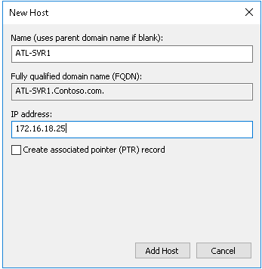
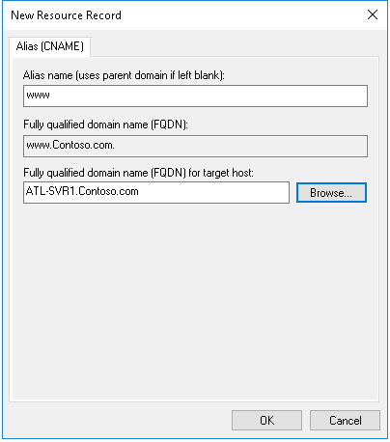
Creating records in DNS
Add-DnsServerResourceRecordA -ZoneName Contoso.com -Name ATL-SVR1 -IpAddress 172.16.18.25
Notes:
Explain that host computers often dynamically create resource records when they contact a DNS server. Point out that resource records can also be created manually, and explain the methods available for doing so in Windows Server 2016.
20741B
4: Implementing DNS

Slide 13
Configuring DNS zones
Namespace: training.contoso.com
Forward zone | Training | DNS Client1 | 192.168.2.45
 |  | DNS Client2 | 192.168.2.46
 |  | DNS Client3 | 192.168.2.47
Reverse zone | 2.168.192.in-addr.arpa | 192.168.2.45 | DNS Client1
 |  | 192.168.2.46 | DNS Client2
 |  | 192.168.2.47 | DNS Client3
DNS Server Authorized
for Training
DNS Client2 = ?
192.168.2.46 = ?
DNS Client1
Notes:
Explain that a DNS zone contains the DNS records for one or more namespaces, and that it can be configured to find an IP address for a given name in a forward lookup zone, or be configured to resolve a name from a given IP address in a reverse lookup zone.
20741B
4: Implementing DNS

Slide 14
What are primary and secondary zones?
Zones | Description
Primary | Read/write copy of a DNS database
Secondary | Read-only copy of a DNS database
Stub | Copy of a zone that contains only records used to locate name servers
Active Directory–integrated | Zone data is stored in AD DS rather than in zone files
Notes:
Explain that there are four DNS zone types:
Primary
Secondary
Stub
Active Directory–integrated
Make the following points about the zones:
Primary Zone:
DNS server is the primary source for zone information.
Primary zone stores the master copy of zone data in either a local file or in AD DS.
Primary zone file is named zone_name.dns by default, and is located in %windir%\System32\Dns.
Secondary Zone:
The server is a secondary source for zone information.
The secondary zone information must be obtained from another DNS server that also hosts the zone.
A secondary zone cannot be stored in AD DS.
Stub zones and Active Directory–integrated zones will be discussed in detail in Lesson 3 and Lesson 4, respectively, in this module.
20741B
4: Implementing DNS

Slide 15




Configuring zone replication
Active Directory–integrated zones
Traditional DNS zones
Replication
Zone transfer
Active Directory– integrated zones
Primary zone
Active Directory– integrated zones
Secondary zone
Zones | Description
Active Directory–integrated zones | Perform incremental replication between DNS servers Adjust the Active Directory replication schedule
Traditional DNS zones | Replicate between primary and secondary zones Perform an incremental rather than a complete zone transfer
Notes:
Define zone transfer, and describe to the students the purpose and process of zone transfers. Describe the DNS zone transfer process by referring to the slide. A zone transfer occurs when the DNS zone that is on one server is transferred to another DNS server. Zone transfers keep primary and secondary DNS server zones synchronized. This is how DNS builds its resilience on the Internet. Emphasize the importance of keeping zones up to date and synchronized.
Briefly discuss the two types of DNS zone transfers, full and incremental:
A full zone transfer occurs when the entire zone is copied from one DNS server to another.
An incremental zone transfer occurs when there is an update to the DNS server, and only the resource records that were changed are replicated to the other server.
Be sure to highlight that Active Directory–integrated zones replicate as part of AD DS, whereas standards-based zone transfers occur as part of DNS zone transfer queries. Describe the process for implementing zone replication between DNS servers.
20741B
4: Implementing DNS

Slide 16
Lesson 3: Configuring name resolution between DNS zones
Resolving DNS names between zones What is a stub zone? What is DNS caching? What is DNS forwarding? DNS forwarding and stub zone guidance Discussion: When to use DNS forwarding Configuring delegation
Notes:
Explain that this is the lesson that covers DNS caching, forwarding, conditional forwarding, and stub zones. Explain that these different ways of configuring DNS to resolve names can be confusing, but that each procedure has a specific purpose.
Question
A stub zone consists of which of the following? (Choose two answers.)
( ) Option 1: The IP address of one or more master servers that you can use to update the zone.
( ) Option 2: Resource records not contained in a DNS server’s zone.
( ) Option 3: A cache of domain names and their associated IP addresses for the most common domains that the organization uses or accesses.
( ) Option 4: Requests for all Internet names forwarded to a DNS server at an Internet service provider (ISP).
( ) Option 5: The delegated zone’s Start of Authority resource record, NS resource records, and A resource records.
Answer
( √) Option 1: The IP address of one or more master servers that you can use to update the zone.
( ) Option 2: Resource records not contained in a DNS server’s zone.
( ) Option 3: A cache of domain names and their associated IP addresses for the most common domains that the organization uses or accesses.
( ) Option 4: Requests for all Internet names forwarded to a DNS server at an Internet service provider (ISP).
( √) Option 5: The delegated zone’s Start of Authority resource record, NS resource records, and A resource records.
20741B
4: Implementing DNS

Slide 17



Resolving DNS names between zones
.root DNS
What is the IP address of www.microsoft.com?
2
1
3
.com DNS
Local DNS Server
Workstation
4
The IP address is
207.46.230.219
Microsoft.com DNS
5
Notes:
Explain the information flow by using the steps in the student notes. Mention to students that understanding this process is important when they troubleshoot name resolution issues for clients and servers, for example, when a client cannot access a web-based app or file server. Note that to find the IP address of www.microsoft.com, a client asks its DNS server as defined in the TCP/IP properties, and that DNS server might then ask several DNS servers in the DNS hierarchy until it has an answer for the client.
20741B
4: Implementing DNS

Slide 18
What is a stub zone?
Without stub zones, the ny.na.contoso.com server must query several servers to find the server that hosts the na.fabrikam.com zone
DNS
Server
contoso.com
(Root domain)
DNS
Server
fabrikam.com
DNS
Server
DNS
Server
DNS
Server
na.contoso.com
sa.contoso.com
DNS
Server
na.fabrikam.com
DNS
Server
ny.na.contoso.com
rio.sa.contoso.com
Notes:
When a zone that a DNS server hosts is a stub zone, the DNS server is a source only for information about the zone’s authoritative name servers. The zone on this server must be obtained from another DNS server that hosts the zone.
The DNS server must have network access to the remote DNS server to copy the zone’s authoritative name server information. Ensure that students understand that you use the stub zone mainly to shorten the delay in querying for records in a foreign zone, while also being made aware of changes to the NS records in that foreign zone.
Begin a classroom discussion by explaining that stub zones and conditional forwarding provide similar functions.
20741B
4: Implementing DNS

Slide 19




What is DNS caching?
DNS server cache
Host name | IP address | TTL
ServerA.contoso.com | 131.107.0.44 | 28 seconds
Internet DNS
Contoso DNS
Internal DNS
ServerA is at 131.107.0.44
Where is
ServerA?
Client1
Where is
ServerA?
ServerA is at 131.107.0.44
Client2
ServerA
Notes:
Explain the purpose of DNS caching. DNS caching increases the performance of the DNS system. Describe how DNS server caching works by referring to the slide. Explain caching-only servers. A caching-only server does not host any DNS zone data. It only answers lookups for DNS clients.
Explain the ideal type of DNS server that should be used as a forwarder. Explain DNS client-side caching. The DNS client cache is a DNS cache stored on the local computer. Conduct an interactive demonstration by asking the students to run the Get-DnsClientCache cmdlet in Windows PowerShell. This enables them to view the DNS cache.
20741B
4: Implementing DNS

Slide 20




What is DNS forwarding?
A forwarder is a DNS server that is designated to resolve external or offsite DNS domain names
Forwarder
Root Hint (.)
Iterative Query
Ask .com
Iterative Query
Ask Contoso.com
.com
Recursive Query
131.107.0.11
Iterative Query
131.107.0.11
Authoritative Response
Recursive Query for
mail1.contoso.com
Contoso.com
Local
DNS
Server
Client
Notes:
Define forwarders and explain their purpose. Use the diagram on the slide to explain the forwarding process.
The client uses a recursive query for mail1.contoso.com. The local name server is not authoritative. However, it is configured to use a forwarder. Rather than using iterative queries to resolve the name itself, the initial DNS server petitions its configured forwarder by using a recursive query. The forwarder then uses root hints, as described in an earlier topic, to resolve and return the required record.
20741B
4: Implementing DNS

Slide 21
DNS forwarding and stub zone guidance
When to use conditional forwarding
Points to a different domain name
Name can even be in a different top level
When you want all name resolution for that name to take a particular path
When to use stub zones
Usually when the domain name is below a higher level
Delegation below a delegation
Notes:
Explain the key differences between conditional forwarding and stub zones. Stub zones are usually with the hierarchy of a particular higher-level domain, whereas conditional forwarding could go anywhere in the Internet.
20741B
4: Implementing DNS

Slide 22




Configuring delegation
DNS Server
Contoso.com
DNS Zone
DNS Subdomain
DNS Zone
Sales
DNS Server
Marketing
Notes:
Explain how to use DNS zone delegation. DNS provides the option of dividing a namespace into one or more zones, which you then can store, distribute, and replicate to other DNS servers.
Explain why you would use delegation. When explaining why you use it, emphasize the difference between zones and domains. Consider demonstrating the process for creating a DNS zone delegation.
20741B
4: Implementing DNS

Slide 23
Lab A: Planning and implementing name resolution by using DNS
Exercise 1: Planning DNS name resolution Exercise 2: Implementing DNS servers and zones
Logon Information
Virtual machines: 20741B-LON-DC1
20741B-EU-RTR
20741B-INET1
20741B-LON-SVR1
20741B-SYD-SVR1
User name: Adatum\Administrator
Password: Pa55w.rd
Estimated Time: 60 minutes
Notes:
Before students begin the lab, read and display the lab scenario slide. Before each exercise, read the scenario associated with the exercise to the class. The scenarios give context to the lab and exercises, and help to facilitate the discussion at the end of the lab. Remind students to complete the discussion questions after the last lab exercise.
Exercise 1: Planning DNS name resolution
You must create a plan for implementing DNS name resolution according to the directions given in the lab scenario. You will be presented with several questions in this exercise. Write down the answers to these questions. This will help you decide how to implement the design.
Exercise 2: Implementing DNS servers and zones
You must install and configure the DNS infrastructure in SYD-SVR1 according to your DNS implementation plan. Your implementation process will involve the following steps:
Install the DNS Server role on SYD-SVR1.
Configure forwarding for Internet and external queries. All external queries should be directed to your ISP’s DNS servers (131.107.0.100).
Configure the forwarding for the contoso.com domain. All DNS queries for contoso.com should be directed to LON-SVR1 (172.16.0.11).
Configure the forwarding for the TreyResearch.net domain. All DNS queries for TreyResearch.net should be directed to LON-SVR1 (172.16.0.11).
20741B
4: Implementing DNS

Slide 24
Lesson 4: Configuring DNS integration with AD DS
Overview of AD DS and DNS integration What are Service Resource Locator records? Benefits of Service Resource Locator records What are Active Directory–integrated zones? Application partitions in AD DS Dynamic updates Demonstration: Configuring AD DS–integrated zones
Notes:
Briefly describe the lesson content.
20741B
4: Implementing DNS

Slide 25











Overview of AD DS and DNS integration
Normal replication traffic
Normal replication traffic
Normal replication traffic
Normal replication traffic
Normal replication traffic
Normal replication traffic
←-------------Domain Controllers----------→
←-------------Domain Controllers----------→
←-------------Domain Controllers----------→
DNS Service
Zone Transfer
Primary DNS Server Secondary DNS Server
Notes:
You can describe the process illustrated in the animated slides in the following way:
The initial slide shows the normal AD DS replication that takes place between domain controllers.
The first click adds the primary and secondary DNS servers, and shows the one-way zone transfer process.
The second click moves the DNS zone to the AD DS database. Note that DNS now uses normal replication to perform zone transfers.
The third click shows that you can optionally decommission the primary and secondary DNS servers.
20741B
4: Implementing DNS

Slide 26
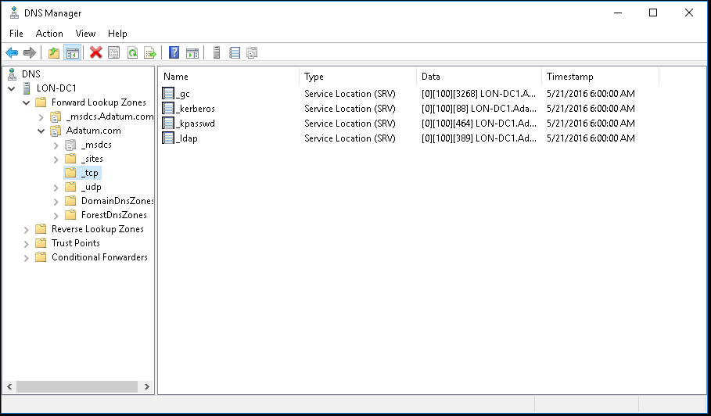
What are Service Resource Locator records?
Domain controllers register SRV records as follows:
_tcp.adatum.com — All domain controllers in the domain
_tcp.sitename._sites.adatum.com — All services in a specific site
Clients query DNS to locate services in specific sites
Notes:
Discuss how SRV resource records help AD DS clients locate services on the network. Focus on how sites play a role in this service location process. Consider showing an example by using the DNS Manager console.
20741B
4: Implementing DNS

Slide 27
Benefits of Service Resource Locator records
Benefits of SRV resource records
Domain controllers register their SRV resource records dynamically, by service and site location
Client systems in sites use SRV resource records recorded in a site to find domain controllers in their own site before attempting to connect to domain controllers across wide area network links
Keeps network traffic across links down and managable
Notes:
Explain how SRV records are used to locate services such as domain controllers and mail servers in sites by integrating SRV resource records and AD DS sites.
20741B
4: Implementing DNS

Slide 28
What are Active Directory–integrated zones?
An Active Directory–integrated zone:
Allows multi-master writes to zone
Replicates DNS zone information by using AD DS replication:
Leverages efficient replication topology
Uses efficient incremental updates for Active Directory replication processes
Enables secure dynamic updates
Delegates zones, domains, and resource records for increased security
Notes:
Explain how DNS stores data in AD DS. Briefly review the benefits.
Question
Are there any disadvantages to storing DNS information in AD DS?
Answer
If you want to replicate DNS data to other non‑Microsoft DNS servers, you should not store it in AD DS.
20741B
4: Implementing DNS

Slide 29
Application partitions in AD DS
Replicate to all domain controllers in the AD DS domain
Domain
Replicate to all domain controllers that are DNS servers in the AD DS domain
Config
Schema
DomainDNSZone
Replicate to all domain controllers that are DNS servers in the AD DS forest
ForestDNSZones
Custom Partition
Replicate to all domain controllers in the replication scope for the application partition
Notes:
If students are not familiar with the concept of AD DS partitions, briefly describe the three main partitions: domain, configuration, and schema.
Next, describe how those partitions can store DNS information. Highlight that, by default, DNS information is stored in different partitions than those that store other AD DS information.
Mention that the default application partitions for storing DNS information in AD DS are created automatically when you install and configure DNS during AD DS installation. To create the partitions after you install AD DS, you can use the DNS management tool or the Dnscmd.exe command-line tool.
List the different partitions that are available for storing DNS information in AD DS. Mention that the primary reason for choosing each of the different zones is that each partition has a different replication scope.
Consider using a diagram to describe the replication scopes for each partition. Include domain controllers that are not DNS servers and domain controllers that are in a different domain, and then show the effects of storing the Active Directory DNS information in each zone.
Provide scenarios for when organizations might choose each option to store the DNS information in each partition. Summarize how to create a custom application partition for storing DNS information.
20741B
4: Implementing DNS

Slide 30
Dynamic updates
The client sends an SOA query
The DNS server returns an SOA resource record
The client sends dynamic update request(s) to identify the primary DNS server
The DNS server responds that it can perform an update
The client sends unsecured update to the DNS server
If the zone permits only secure updates, the update is refused
The client sends a secured update to the DNS server
Client
1
2
3
4
5
6
7
DNS Server
Resource Records
Notes:
Describe how dynamic updates work. Explain to students that when an IP address is configured (by DHCP or is fixed), it is the DHCP client service, not the DHCP server, that registers a client’s host records. This is triggered when an IP address is added or changed on any network connection. Registration also happens during computer startup. Remind students that they can also activate registration manually by using the Windows PowerShell cmdlet Register-DNSClient, or by typing the ipconfig /registerdns command at a command prompt.
Ask students what they think would happen if dynamic updates were not enabled. They should answer that the biggest problem would be that domain controllers would not be able to register their records in DNS, so the domain controller records would have to be added manually.
Mention to students that there is an option that they can set in the DHCP server so that it can update client computer resource records in DNS dynamically. Mention that, by default, Windows Server 2016 DNS servers are configured to support secure-only updates for Active Directory–integrated zones. Active Directory–integrated zones are covered in more detail in the next topic.
20741B
4: Implementing DNS

Slide 31
Lab B: Integrating DNS with AD DS
Exercise 1: Integrating DNS with AD DS
Logon Information
Virtual machines: 20741B-LON-DC1
20741B-LON-SVR1
20741B-INET1
20741B-EU-RTR
20741B-SYD-SVR1
User name: Adatum\Administrator
Password: Pa55w.rd
Estimated Time: 20 minutes
Notes:
Exercise 1: Integrating DNS with AD DS
You need to deploy another Active Directory-integrated DNS server in Adatum.com. To do this, you will promote SYD-SVR1 to a domain controller, and integrate DNS with the AD DS database for Adatum.com.
20741B
4: Implementing DNS

Slide 32
Module Review and Takeaways
Review Questions Tools Best Practices Common Issues and Troubleshooting Tips
Notes:
Review Questions
Question
You are troubleshooting DNS name resolution from a client computer. What must you remember to do before each test?
Answer
You should clear the resolver cache before starting to troubleshoot.
Question
You are deploying DNS servers into an Active Directory domain, and your customer requires that the infrastructure be resistant to single points of failure. What must you consider when planning the DNS configuration?
Answer
You should deploy more than one AD DS domain controller with the DNS Server role installed.
Question
What benefits do you realize by using forwarders?
Answer
Forwarders are used when your local DNS server cannot resolve a query from the client using its own local zones. You usually configure forwarders to resolve Internet names. However, you also can use forwarders to optimize performance, to optimize Internet link usage on your local DNS server, and to enhance security.
20741B
4: Implementing DNS
(More notes on the next slide)

